Slide 1
EU National and Foreign workers
By Viktoriya Shirochenkova
Notes:
In each of the EU country we will look at the relationship between nationals and foreigners and employed and unemployed.
National workers are those who have a citizenship in the residing country and foreign workers do not.

Slide 2
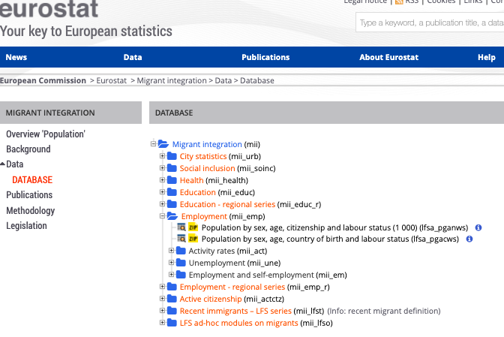
DATA
Eurostats: Migrant Database
https://ec.europa.eu/eurostat/web/migrant-integration/data/database

Slide 3
DATA
Original data
Population by sex, age, citizenship and labour status
Data extracted per country for 2010-2019
Nationals employed
Nationals unemployed
Foreigners employed
Foreigners unemployed
Notes:
Original data contained 52650 rows × 9 columns

Slide 4
DATA
Additional derived data
Change y/y for active foreigners and nationals
Change y/y for employed foreigners and nationals
Change y/y for unemployed foreigners and nationals

Slide 5
STORIES
Story 1: Foreigners take jobs away from nationals
Story 2: Foreigners migrate only when there are jobs available
Story 3: There is no relation between migration rate and unemployment rate

Slide 6
HYPOTHESIS
H₀: Migration rate is not related to unemployment rate.
H₁: Migration rate is related to unemployment rate.
Notes:
From story 3 we derived the following hypothesis

Slide 7
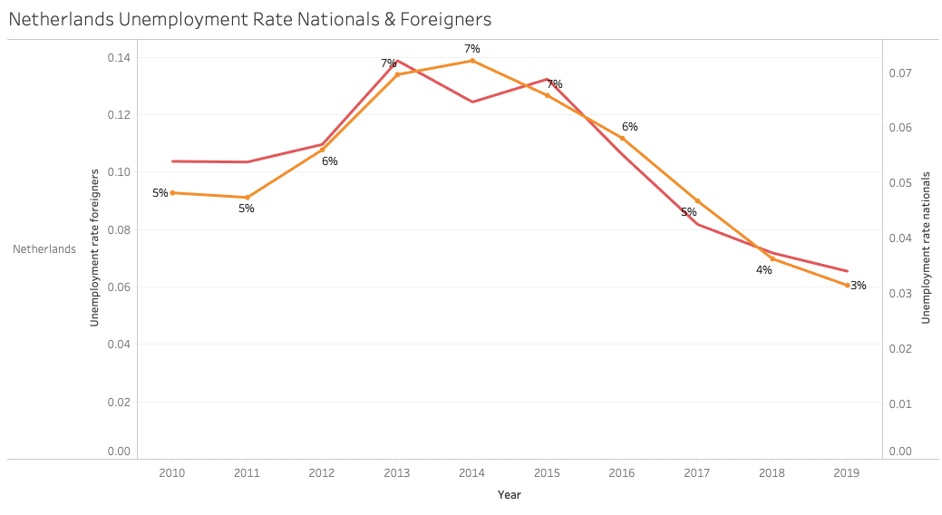
Notes:
I choose to focus on 3 countries: Netherlands - its our home and a dynamic country), Germany (as it is the biggest economy in Europe) and Spain is it is one of the biggest economies in Europe that has high chronic unemployment and a relatively high migration rate.
Starting with Netherlands, this graph shows unemployment rate for Dutch nationals and Dutch foreigners spanning over 10 years. The orange line represents unemployment rate for nationals and red line for foreigners. We see that both lines are very similar, thus the Dutch market treats both national and foreign workers the same.

Slide 8
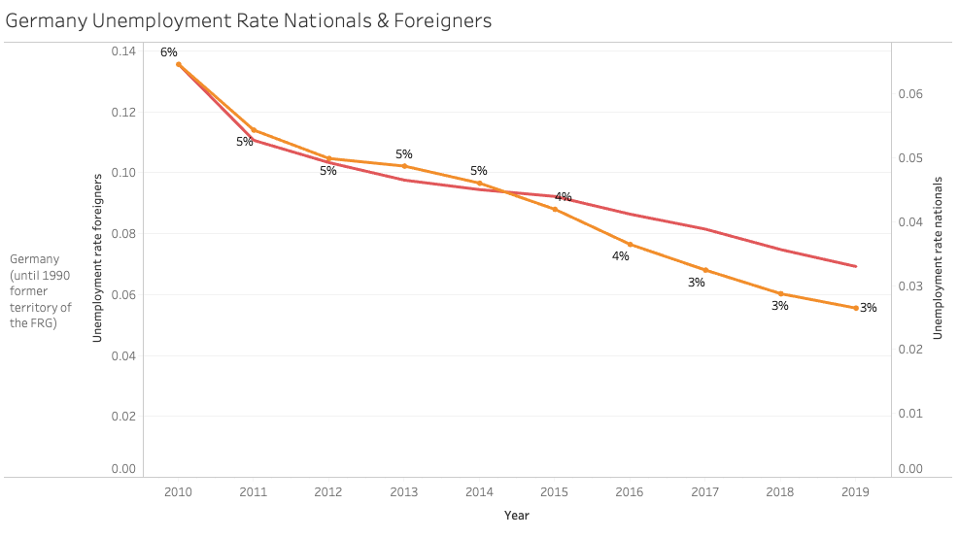
Notes:
Here we also see that both lines are very similar, with a slight decrease of unemployment rate for nationals than foreigners starting from 2015.

Slide 9
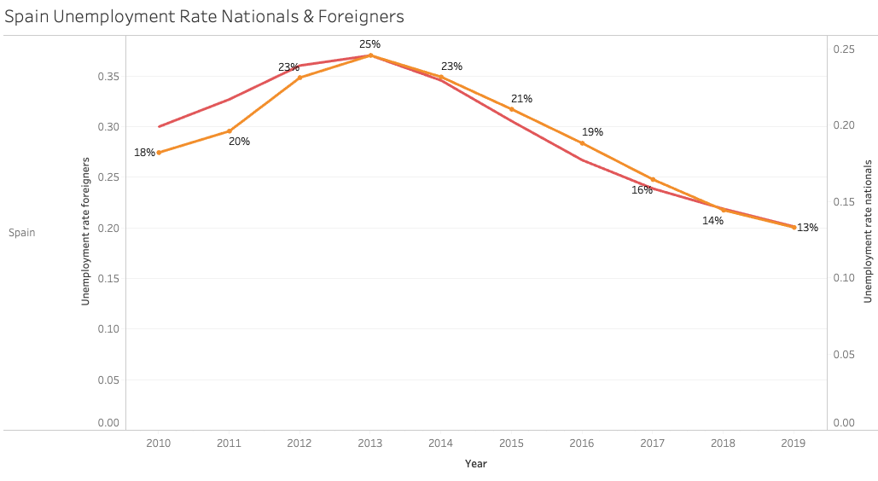
Notes:
Here we once again see similarities in both lines and interesting fact to note is that for 2018 and 2019 unemployment rate for nationals and foreigners is the same.

Slide 10
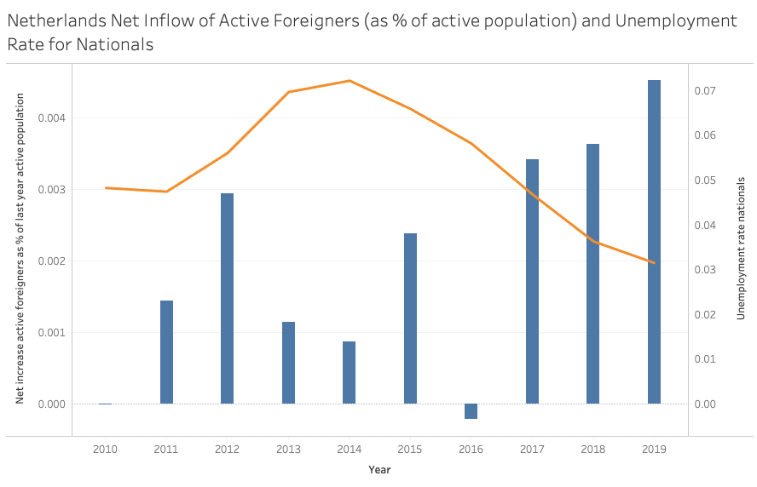
-0.59
Notes:
I want to look at how relative net flow of immigrants compares with national unemployment rate. This graph shows an unemployed rate for Dutch nationals changing from year to year and the net flow of immigrants as a % of last years total active population. This graph is measuring the impact on the changes of foreigners into the TOTAL ACTIVE POOL.
2 things to notice: the bars (immigrant flows) represent much smaller number than the line which represents unemployment rate for nationals and they do NOT move together.

Slide 11
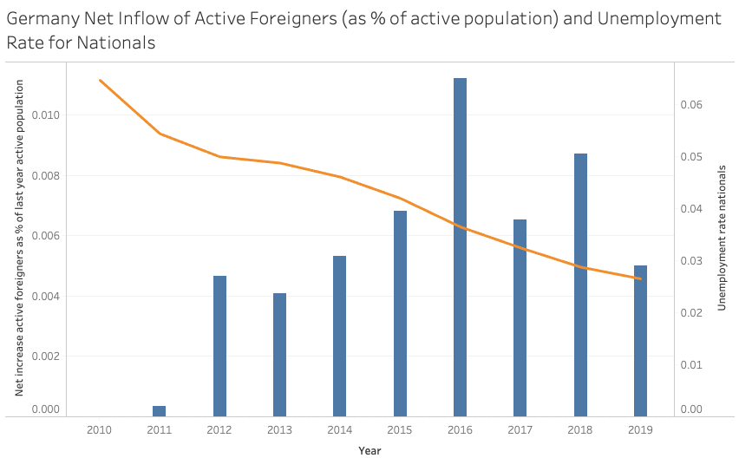
-0.76
Notes:
This graph shows an unemployed rate for German nationals changing from year to year and the net flow of immigrants as a % of last years total active population. Important to note, that in 2016 the largest flow of immigrants measured at 1% came into the country and still unemployed rate is going down.

Slide 12
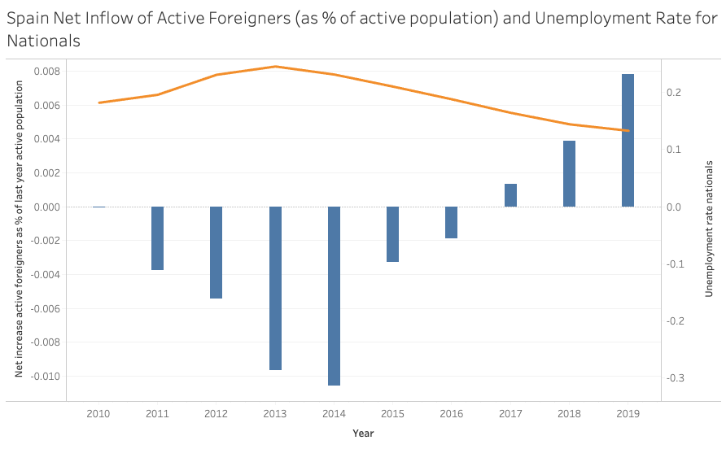
-0.97
Notes:
Spain has chronic high unemployment, we can see that they reached about 25% in 2013. In this graph, we see foreigners leaving the country from 2011-2016 as unemployment rate increases.
Lets also notice, the magnitude of the outflow of immigrants in 2014 of roughly -1% compares to Germany 1% in 2016 which was the same number but in opposite direction. Measuring the impact on the changes of foreigners into the TOTAL ACTIVE POOL.
During the recovery, it’s important to note that unemployment goes down and foreigners come in. There is an almost near perfect negative correlation in Spain of -0.97.

Slide 13
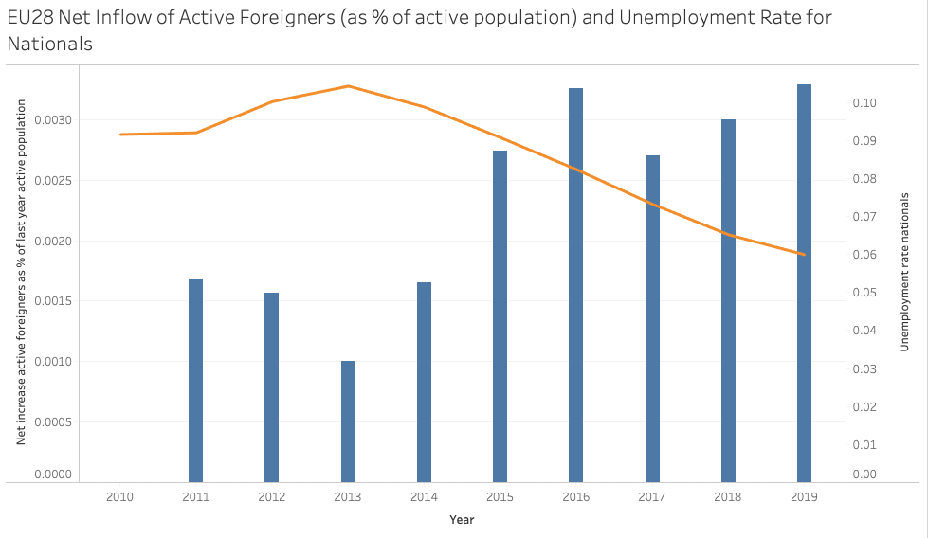
Notes:
Bear in mind that this graph is not ideal as there is double counting due to the fact that immigrants from one part of Europe going to another affect the unemployment rate in two countries instead of one. Still we see an increase of net flow of immigrants as unemployment rate is going down. If our story 1 is true they would move together.

Slide 14
HYPOTHESIS testing
H₀: Migration rate is not related to unemployment rate.
H₁: Migration rate is related to unemployment rate.
Related t-test function (unemployed nationals vs change of active foreigners)
NL Result (p-value < 0.05)
DE Result (p-value < 0.05)
SP Result (p-value < 0.05)
Notes:
Going back to story 3, which says that national’s unemployment is not related to migrant flows.
We are testing how far from the mean each of two variables are - the variables being unemployed nationals & change of active foreigners
Our p-value is small for Netherlands, Germany and Spain meaning we reject the null hypothesis that migration rate is not related to unemployment rate. In other words, we could say that migration rate is related to unemployment of nationals, however they don’t have to move in the same direction.

Slide 15
Correlations: unemployed nationals vs the inflow/outlow of foreigners
Netherlands | -0.59
Germany | -0.76
Spain | -0.97
Notes:
When unemployment goes up the inflow of immigrants goes down and vice versa

Slide 16
Conclusions
Story 3: Migration rate and unemployment rate are related
Story 1 vs Story 2: These variables seem to be inversely related (Germany 2016 and Spain 2014). Story 2 is stronger.
Further study: look into measuring lag effects (migration affecting unemployment with a delay)
Notes:
Story 3: There is no relation between migration rate and unemployment rate (discard this)
Story 2: Foreigners migrate only when there are jobs available (this looks stronger than story 1, we saw this in Germany and Spain. Unemployment goes down when foreigners come in.
Story 1: Foreigners take jobs away from nationals (foreigners come in unemployment goes up)
Measuring lag effects (migration affecting unemployment with a delay)

